Slide 1
Chapter 2
Variables and Assignments

Slide 2
Variables
Variable
A variable represents a memory location used to store data.
Declaration
type name;
type name = initialValue;
int x = 10;
Assignment
name = expression
Expression is the right side of an assignment
x = 10;
Think "x gets 10"
Recipient always goes on the left
Not the same as math =

Slide 3
Identifiers
Name of a variable
Can contain letters (a-z, A-Z), digits (0-9), and _
Cannot start with a digit
int 9var; ///nope
int var9; ///yup
Reserved word / keyword
Part of the language
int, double, while, if, etc.
Identifiers cannot use keywords
int for; ///nope

Slide 4
Arithmetic Expressions
Operators
+,-,*,/,%
- can also be a unary (1 operand) negation eg -x
Integer Division
When both operands are integers, / throws away the remainder.
Divide by 0
Any division by 0 causes the program to crash at runtime
cout << 24 / 10 << endl; /// == 2
cout << 50 / 50 << endl; /// == 1
cout << 1 / 2 << endl; /// == 0
int x = 2, y = 3;
int z = x / y;
cout << z << endl; /// ==0
cout << x / z << endl; ///mysterious crash
cout << "End" << endl;

Slide 5
Arithmetic Expressions
% gives remainder of division
cout << 24 % 10 << endl; /// == 4
cout << 50 % 50 << endl; /// == 0
cout << 1 % 2 << endl; /// == 1
cout << 7 % 23423 << endl; /// == 7
^ is not the exponential operator, requires math library function
#include <cmath>
…
int x = 4;
cout << (x ^ 2) << endl; /// == 6 ??
cout << pow(x, 2) << endl; /// == 16
Precedence rules similar to PEMDAS from math
Parentheses, Exponents, negation, Multiply / Divide, Addition / Subtraction
Operators with same precedence are evaluated left to right
Group with parentheses when in doubt

Slide 6
Arithmetic Expressions
#include <iostream>
using namespace std;
int main() {
int userMinutes = 0; // User input: Minutes
int outHours = 0; // Output hours
int outMinutes = 0; // Output minutes (remaining)
cout << "Enter minutes: " << endl;
cin >> userMinutes;
outHours = userMinutes / 60;
outMinutes = userMinutes % 60;
cout << userMinutes << " minutes is ";
cout << outHours << " hours and ";
cout << outMinutes << " minutes." << endl;
return 0;
}

Slide 7
Compound Operators
x = x + 1
Same as x += 1;
Also -=, *=, /=, %=

Slide 8
Numeric data ranges for 1 byte (8 bits)
11111111
11111110
11111101
11111100
…
…
00000011
00000010
00000001
00000000
255
254
253
252
…
…
3
2
1
0

Slide 9
Numeric data types
Declaration | Size | Supported number range | Standard-defined minimum size
unsigned char myVar; | 8 bits | 0 to 255 | 8 bits
unsigned short myVar; | 16 bits | 0 to 65,535 | 16 bits
unsigned long myVar; | 32 bits | 0 to 4,294,967,295 | 32 bits
unsigned long long myVar; | 64 bits | 0 to 184,467,440,737,095,551,615 | 64 bits
unsigned int myVar; | 32 bits | 0 to 4,294,967,295 | 16 bits

Slide 10
Numeric data types
Declaration | Size | Supported number range | Standard-defined minimum size
char myVar; | 8 bits | -128 to 127 | 8 bits
short myVar; | 16 bits | -32,768 to 32,767 | 16 bits
long myVar; | 32 bits | -2,147,483,648 to 2,147,483,647 | 32 bits
long long myVar; | 64 bits | -9,223,372,036,854,775,808 to 9,223,372,036,854,775,807 | 64 bits
int myVar; | 32 bits | -2,147,483,648 to 2,147,483,647 | 16 bits

Slide 11
Floating-point (double)
Stores fractional numbers. Uses some bits to store a base and some bits to store an exponent
Similar to scientific notation
ie 2.5 becomes 1.01 x 2^1
double x = 1.5;
double y = 6.38e6
Scientific notation, stores 6.38 x 10^6
float uses 4 bytes, has about 7 significant digits of precision
double uses 8 bytes, has about 15 significant digits of precision

Slide 12
Floating-point numeric data types
Declaration | Size | Supported number range
float x; | 32 bits | -3.4x10³⁸ to 3.4*10³⁸
double x; | 64 bits | -1.7x10³⁰⁸ to 1.7*10³⁰⁸

Slide 13
Constants
Values cannot be changed.
Compiler will flag an error if tried
Good for known quantities
Speed of sound
tax rate
km per mile
const type name;
Use CAPS for the name, with underscore
#include <iostream>
using namespace std;
const double SPEED_OF_SOUND_F_S = 1125.33;
int main()
{
double t_sec = 5.5;
double distance = SPEED_OF_SOUND_F_S * t_sec;
cout << "Distance from lightning heard " << t_sec << " after observed flash: " << distance << " ft" << endl;
}

Slide 14
Math functions
#include <cmath>
Example (distance between two points):
#include <iostream>
#include <cmath>
using namespace std;
int main()
{
double x1 = 1.0;
double y1 = 2.0;
double x2 = 1.0;
double y2 = 5.0;
double pointsDistance = 0.0;
pointsDistance = sqrt(pow((x2 - x1), 2)+ pow((y2 - y1), 2));
cout << "Points distance: " << pointsDistance << endl;
return 0;
}
pow | Raise to power |  | cos | Cosine
sqrt | Square root |  | sin | Sine
 |  |  | tan | Tangent
exp | Exponential function |  | acos | Arc cosine
log | Natural logarithm |  | asin | Arc sine
log10 | Common logarithm |  | atan | Arc tangent
 |  |  | atan2 | Arc tangent with two parameters
ceil | Round up value |  | cosh | Hyperbolic cosine
fabs | Compute absolute value |  | sinh | Hyperbolic sine
floor | Round down value |  | tanh | Hyperbolic tangent
fmod | Remainder of division
abs | Compute absolute value |  | frexp | Get significand and exponent
 |  |  | ldexp | Generate number from significand and exponent
 |  |  | modf | Break into fractional and integral parts

Slide 15
Integer Division
double x = 2/3;
2 and 3 are both integers, compiler stores result as an integer
Integers cannot store fractions
0.666666… becomes 0, fraction is "truncated"
0 then gets converted to a double to be assigned to x
Implicit conversion
Fraction is already lost
To fix this, make one or more operands a double:
double x = 2.0 / 3;
double x = 2 / 3.0;
double x = 2.0 / 3.0
Implicit conversion
if either operand is a double, the other is converted

Slide 16
Type Conversions
Explicit conversion (casting)
Force a variable to be a different type
static_cast<type>(expression)
double y = 2.5; int x = static_cast<int>(y); //x is assigned 2
Can also just use (type)expression
double y = 2.5; int x = (int)y; //same result

Slide 17
Type Conversions
Average # of kids per family
Without the cast, an integer divide is performed
Outputs 3 instead of 3.5
Only one of the operands in the expressions needs to be a double.
#include <iostream>
using namespace std;
int main() {
int kidsInFamily1 = 3; // Should be int, not double
int kidsInFamily2 = 4; // (know anyone with 2.3 kids?)
int numFamilies = 2; // Should be int, not double
double avgKidsPerFamily = 0.0; // Expect fraction, so double
avgKidsPerFamily = static_cast<double>(kidsInFamily1 + kidsInFamily2)
/ static_cast<double>(numFamilies);
cout << "Average kids per family: " << avgKidsPerFamily << endl;
return 0;
}

Slide 18
Char
Uses 1 byte to store a single character
char literals in single quotes
'A' – 'Z' stored as 65 to 90
'a' – 'z' are 97 to 122
'0' – '9' are 48 to 57
Example:
char c = 'A';
c+=1;
cout << c << endl; //outputs B
cout << (int)c << endl; //outputs 66

Slide 19
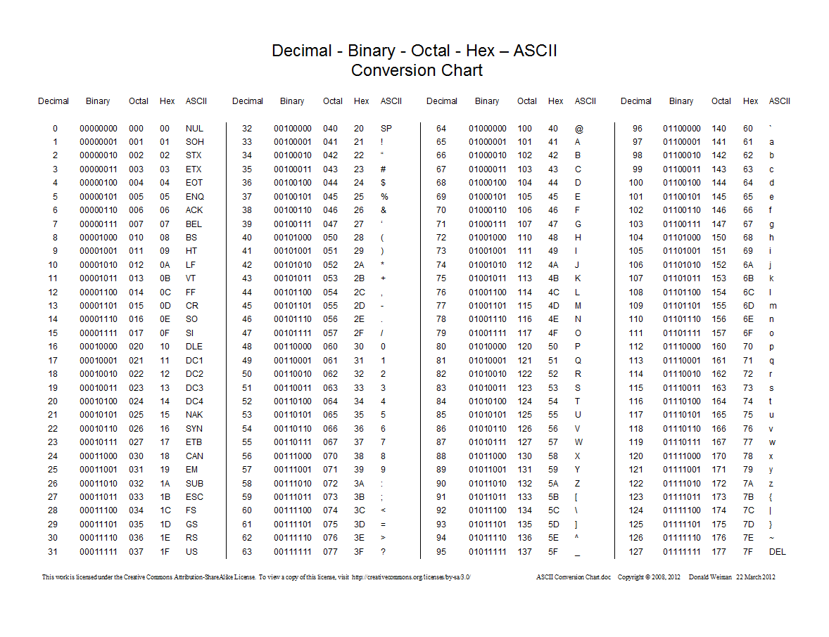
ASCII Table

Slide 20
Char
Escape sequence | Char
\n | newline
\t | tab
\' | single quote
\" | double quote
\\ | backslash

Slide 21
Whitespace
Whitespace character
character used to print spaces in text, and includes spaces, tabs, and newline characters
includes ' ', '\t', '\n'

Slide 22
Overflow
An overflow happens when a literal value exceeds the range of a data type
This code uses a loop. We will go over this more in a later chapter.
Since an unsigned char goes from 0 to 255, when it reaches 256 it will wrap back around to 0.
Floats and doubles will just output "inf" (infinity) when they overflow
#include <iostream>
using namespace std;
int main()
{
unsigned char c = 0;
//Disclaimer. I'm using a loop
//but I haven't taught them to you yet.
for(int i = 0; i < 300; i = i + 1)
{
cout << (int)c << endl; //output the char as an int value
c += 1;
}
return 0;
}

Slide 23
String Basics
A string is actually an array of characters
"Hello" is stored as {'H','e','l','l','o'}
string is not a built in data type
Can be imported using #include <string>
#include <iostream> already imports <string>
string name = "text";

Slide 24
String input
cin >> stringVar
Gets one word at a time
Stops before whitespace ('\n', '\t', ' ')
Skips over leading whitespace characters
getline(cin, stringVar)
Gets an entire line of text
Stops after newline ('\n')

Slide 25
cin vs getline
Assume the user types:
Bob Thomas AZ 31
cin:
#include <iostream>
using namespace std;
int main()
{
string firstName, lastName, city;
int playerNum;
string str;
cin >> firstName >> lastName >> city >> playerNum;
cout << firstName << ' ' << lastName << ", " << city << ", " << playerNum;
}
getline:
Gets the whole line at once
Only stored as one string
#include <iostream>
using namespace std;
int main()
{
string s;
getline(cin, s);
cout << s << endl;
}

Slide 26
cin vs getline
Mixing getline and cin
getline after cin will have errors in the input
If mixing, put cin.ignore() after the cin:
#include <iostream>
using namespace std;
int main()
{
string s1, s2;
cin >> s1;
getline(cin, s2);
cout << s1 << endl;
cout << s2 << endl; ///nothing stored in s2
}
#include <iostream>
using namespace std;
int main()
{
string s1, s2;
cin >> s1;
cin.ignore();
getline(cin, s2);
cout << s1 << endl;
cout << s2 << endl; ///no more error
}
This removes \n left behind by cin

Slide 27
Random numbers
#include <cstdlib>
rand()
returns a random integer each time the function is called, in the range 0 to RAND_MAX: [0…RAND_MAX]
RAND_MAX is usually either INT_MAX (~ 2 billion) or SHRT_MAX (~32000)

Slide 28
Random numbers
Restrict the range using %
How would we generate a random in range [0…5]?
rand() % 6
rand() % n will always return a number between 0 and n-1
How would be generate a random in range [5…10]?
rand() % 6 + 5
The +5 shifts the minimum up by 5
To create a random number x in range [a…b]:
int x = rand() % (b - a + 1) + a
(b - a + 1) is the number of values between a and b
the + a shifts the minimum value from 0 to a

Slide 29
Random numbers: Seeding
rand() will always generate the same pattern unless it is given a different starting point, or seed
srand(intVar)
seed rand
In homework problems, we will all seed with the same value for testing
time()
#include <ctime>
time(0) returns number of seconds since 1970
This is a good way to create a unique seed

Slide 30
Random numbers
Example: Generate two random numbers in range [100,149]:
#include <iostream>
#include <cstdlib> // Enables use of rand()
#include <ctime> // Enables use of time()
using namespace std;
int main()
{
int seedVal = 0;
seedVal = time(0); ///this will change the seed each second
srand(seedVal);
cout << rand() % 50 + 100 << endl;
cout << rand() % 50 + 100 << endl;
return 0;
}

Slide 31
Debugging
Can insert print statements
Code Blocks uses GDB, an integrated debugger
Build using a project
Click the red run button on the right to run with debugger
Set breakpoints
Click on column to the left of code, red dot appears
Code will stop here
Debug->next line
Debug->step into
Debug->debugging windows->watches
Watch variable values as you step through code
Right click on a variable->add to watch

